Slide 1
Website Prime-Fitness
Group-4
Members:
Vu Minh Phat (Leader) Student-1219696
Tran Hoang Anh Student-1219210
Ho Ngoc Duc Student-1219661
Instructor: Truong Ngoc Khac Nguyen

Slide 2
Introduce the content of the project
Prime-fitness gives us a better understanding of what sport is,
a program that helps readers gain more knowledge and apply it easily,
Prime-Fitness brings practice. health and fitness with a healthy physique
The functions of the software program include:
Admin and system register with login ,
at the same time users can post the articles we learn,
and shared with the community.

Slide 3
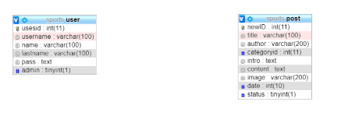
Datebase Prime-Fitness

Slide 4
The following is the demo

